Slide 1
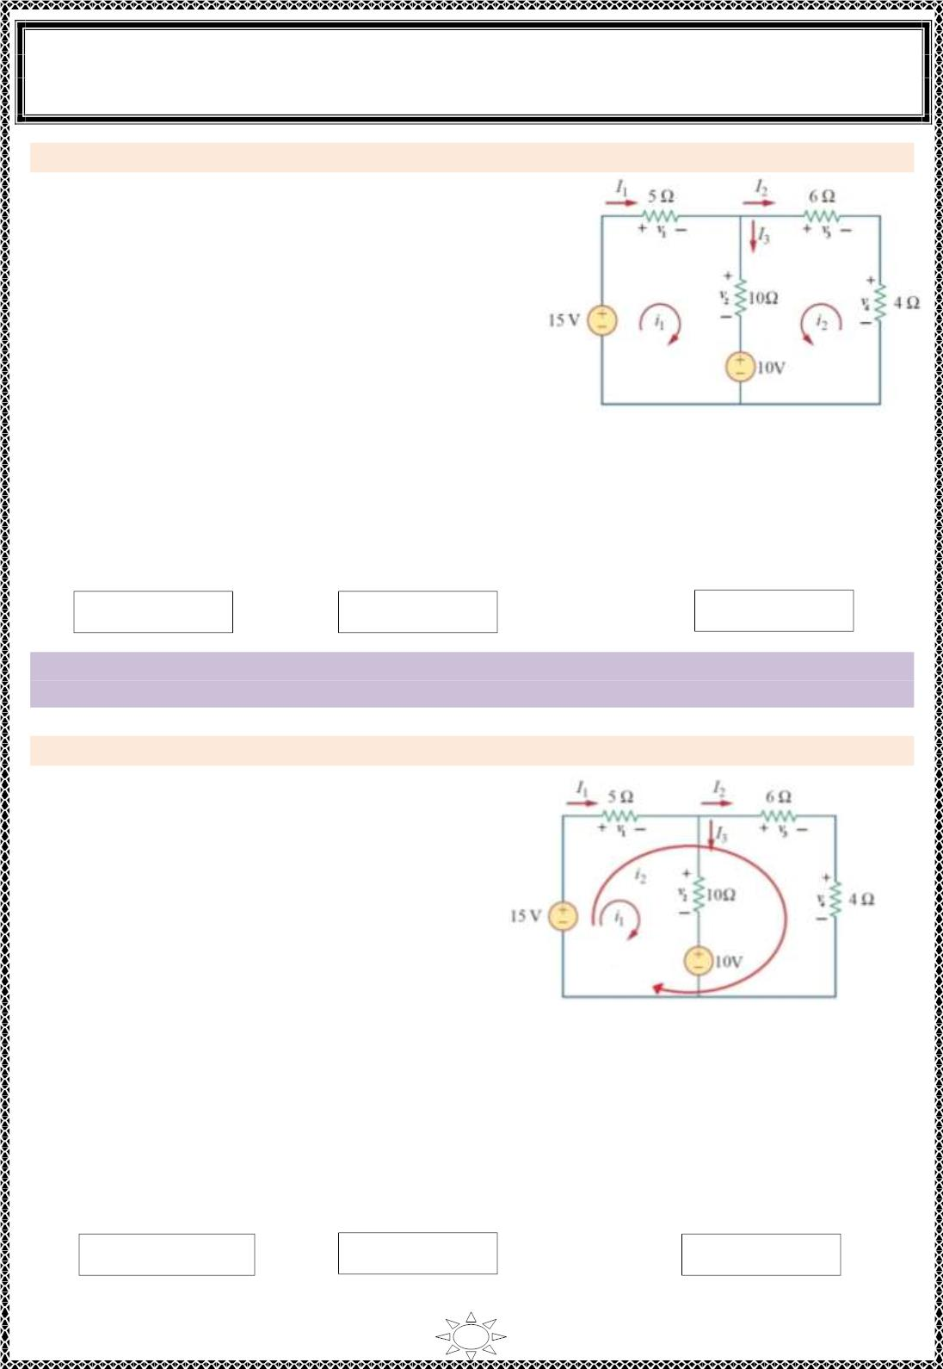
University of Diyala
Engineering College
Electronic Department
Electrical Engineering Fundamentals
1st Class
Asst., Lecturer : Wisam N. AL-Obaidi
Year (2013-2014)
Example 6: Repeat Example (6) for the mesh indicated in Figure (5.14).
Solution:
For mesh (1):
–15 + v + v + 10 = 0, v = 5i & v = 10(i + i )
1
2
1
1
2
1
2
–15 + 5i + 10(i + i ) + 10 = 0
1
1
2
15i + 10i = 5 } ÷ 5
∴ 3i + 2i = 1
1
2
…(1)
1
2
For mesh (2):
–v – v + v + 10 = 0,
v = –6i & v = –4 i
3 2 4 2
3
4
2
Figure (5 .14)
6i + 4 i + 10(i + i ) + 10 = 0
2
2
1
2
10i + 20i = –10 } ÷ 10
1
2
∴ i + 2i = –1
…(2)
1
2
Solve Equ.s (1) & (2) simultaneously or by Grammer's rule or by matrix inv ers io n method
to find mesh currents,
∴ i = 1A, i = –1A
1
2
I = i = 1A,
I = –i = 1A
&
I = i +i = 0A
3 1 2
1
1
2
2
Trail Version
Trail Version
Trail Version
Trail Version
Trail Version
Trail Version
Trail Version
Trail Version
Trail Version
Trail Version
Trail Version
Trail Version
Trail Version
Note:- the elements currents must be same although the mesh paths are different but the
mesh currents may be different which depend on the mesh paths.
Example 7: Repeat Example (6) for the mesh indicated in Figure (5.15).
Solution:
For mesh (1):
–15 + v + v + 10 = 0
1
2
v = 5(i + i ) & v = 10i
1
1
2
2
1
–15 + 5(i + i ) + 10i + 10 = 0
1
2
1
15i + 5i = 5 } ÷ 5
1
2
∴ 3i + i = 1
…(1)
1
2
For mesh (2):
Figure (5.15)
–15 + v + v + v = 0
1
3
4
v = 6i & v = 4 i
3
2
4
2
–15 + 5(i + i ) + 6i + 4 i = 0
1
2
2
2
5i + 15i = 15 } ÷ 5
1
2
∴ i + 3i = 3
…(2)
1
2
Solve Equ.s (1) & (2) simultaneously or by Grammer's rule or by matrix inv ers io n method
to find mesh currents,
∴ i = 0A, i = 1A
1
2
I = i + i = 1A,
I = i = 1A
&
I = i = 0A
3 1
1
1
2
2
2
Same results for elements currents and different mesh currents.
71

Slide 2
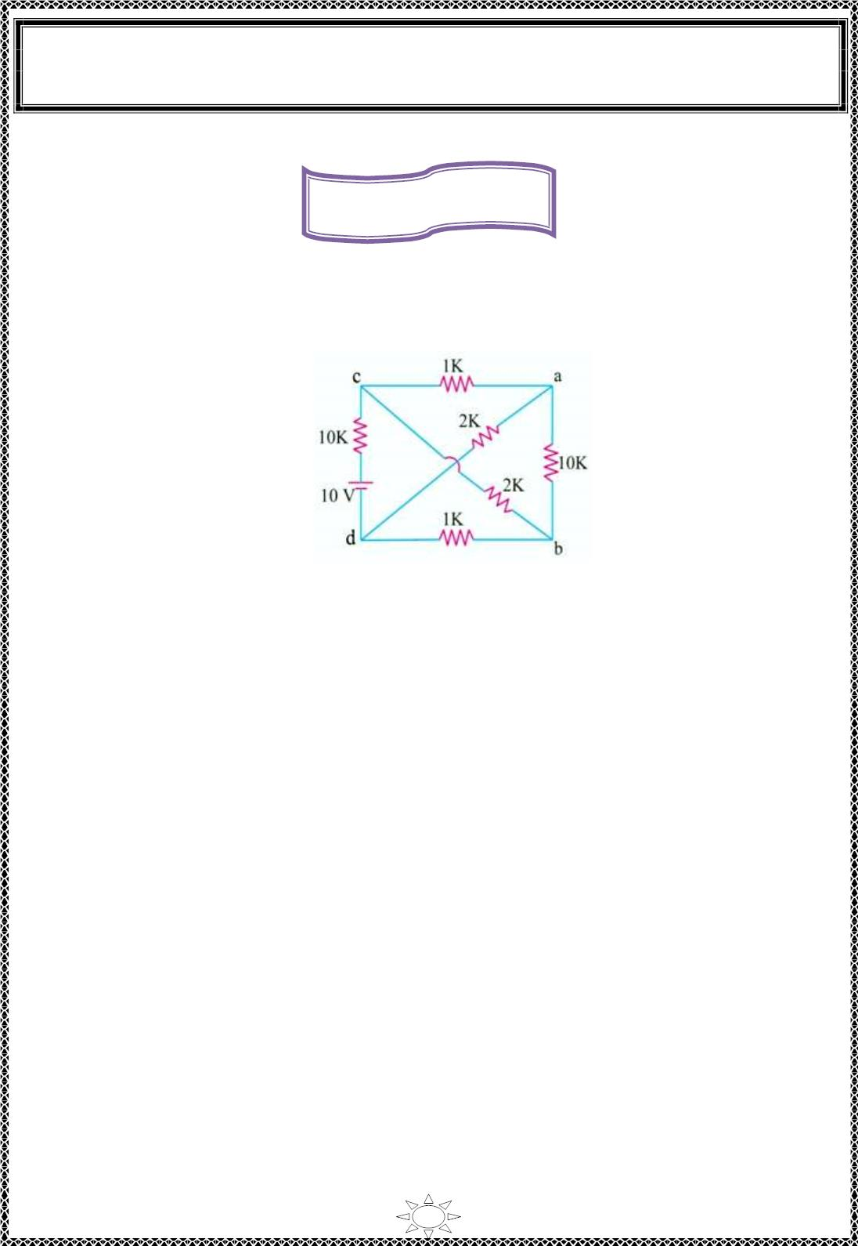
University of Diyala
Engineering College
Electronic Department
Electrical Engineering Fundamentals
1st Class
Asst., Lecturer : Wisam N. AL-Obaidi
Year (2013-2014)
Home Works
H.W.(1): Use mesh analys is to determine the branch currents for the c irc uit shown in
Figure (5 .16).
Trail Version
Trail Version
Trail Version
Trail Version
Trail Version
Trail Version
Trail Version
Trail Version
Trail Version
Trail Version
Trail Version
Trail Version
Trail Version
Figure (5 .16)
72

Slide 3

University of Diyala
Engineering College
Electronic Department
Electrical Engineering Fundamentals
1st Class
Asst., Lecturer : Wisam N. AL-Obaidi
Year (2013-2014)
L ectur e (6)
Superposition
If a circuit has two or more independent sources, one way to determine the value of a
specific var iab le (vo ltage or current) is to us e nodal or mesh analys is.
Another way is to determine the contribut ion of each independent source to the variable
and then add them up. The latter approach is known as the superposition.
The id ea of superposit ion rests on the linearity property.
The s uperpos it ion princip le states that the vo ltage across (or current through) an
element in a linear c ircuit is the algebraic sum of the vo ltages across (or currents
through) that element due to each independent source acting alone.
Steps to Apply Superposition Principle:
1) Turn off all independent sources (where voltage sources replaced by short c irc uit
Trail Version
Trail Version
Trail Version
Trail Version
Trail Version
Trail Version
Trail Version
Trail Version
Trail Version
Trail Version
Trail Version
Trail Version
Trail Version
and current sources replaced by open circuit ) except one source. Find the output
(voltage or current) due to that active source using the techniques discussed
previous ly such as Ohm's law, Kirchhoff's laws, Source transformations, Mesh
current and nodal Analysis.
Note: Dependent sources are left intact (don't turn off) because they are controlled
by c irc uit variab les.
2) Repeat step 1 for each of the other independent sources.
3) Find the total contr ibut ion by adding algebraically all the contributions due to
the independent sources.
However, superposit ion does help reduce a complex circuit to simpler c irc uits through
replacement of voltage sources by short circuits and of current sources by open circuits.
Keep in mind that superposit ion is based on linearity. For this reason, it is not applic able to
the effect on power due to each source, because the power absorbed by a resistor depends
on the square of the voltage or current. If the power va lue is needed, the current through
(or voltage across) the element must be calculat ed first us ing superposition.
73

Slide 4
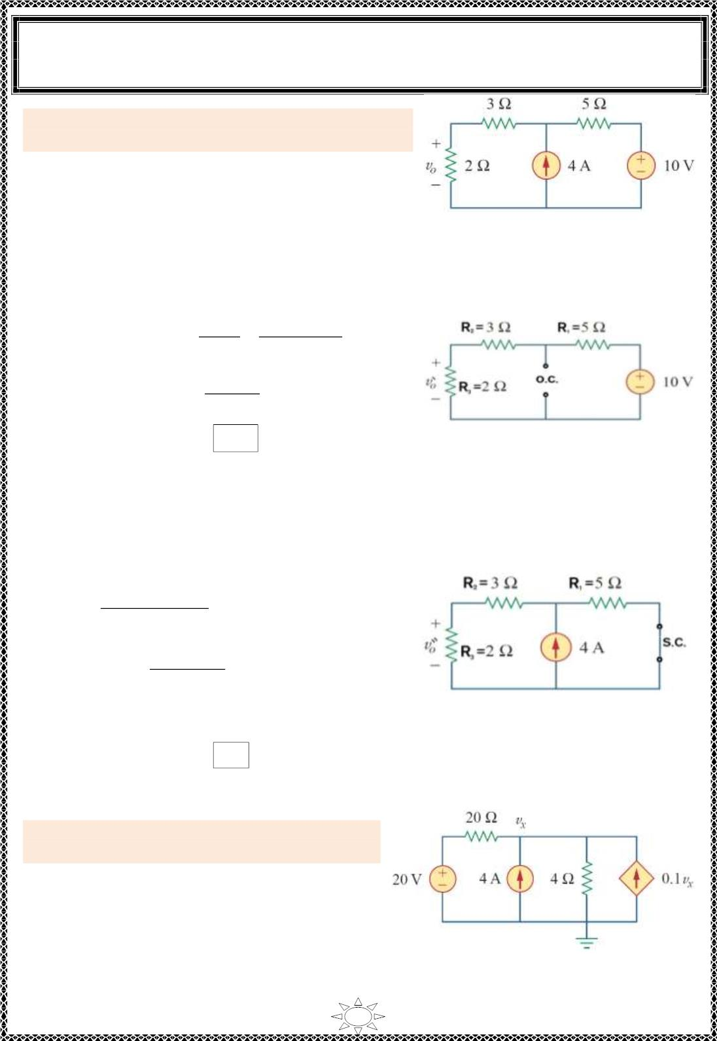
University of Diyala
Engineering College
Electronic Department
Electrical Engineering Fundamentals
1st Class
Asst., Lecturer : Wisam N. AL-Obaidi
Year (2013-2014)
Example 1: Using the superposition theorem, find
v_{o} in the circuit of Figure (6 .1) s hown below.
Solution:
Figure (6.1 )
1) Let the voltage source of (10 V) acting through the c ircuit and turn off the independent
current source by rep lac in g it by an open circuit and redraw the c ircuit as shown b elo w.
The total current I_{total}
V
V
=
=
R_{total}
R + R + R
3
1
2
10
5+ 3 +2
=
= 1 A
∴ 푣_{표}′ = 2 × Itotal = 2 × 1 = 2 V
Figure (6.2)
Trail Version
Trail Version
Trail Version
Trail Version
Trail Version
Trail Version
Trail Version
Trail Version
Trail Version
Trail Version
Trail Version
Trail Version
Trail Version
2)Let the current source of (4 A) acting through the circuit and turn off the independent
voltage source by replacing it by short circuit and redraw the circuit as s hown b elo w.
Use current divis ion rule,
I = I ×
R₁
R3
s
R + (R + R )
1
2
3
= 4 ×
5
= 2 A
5+ (3+2)
∴ 푣′′ = 2 × I = 2 × 2 = 4 V
Figure (6.3 )
표
R3
∴ v = 푣′ + 푣′′ = 2 + 4 = 6 V
o
표
표
Example 2: Use superposition to find v_{x} in the
circuit of Figure (6.4) s hown below.
Figure (6 .4)
74

Slide 5
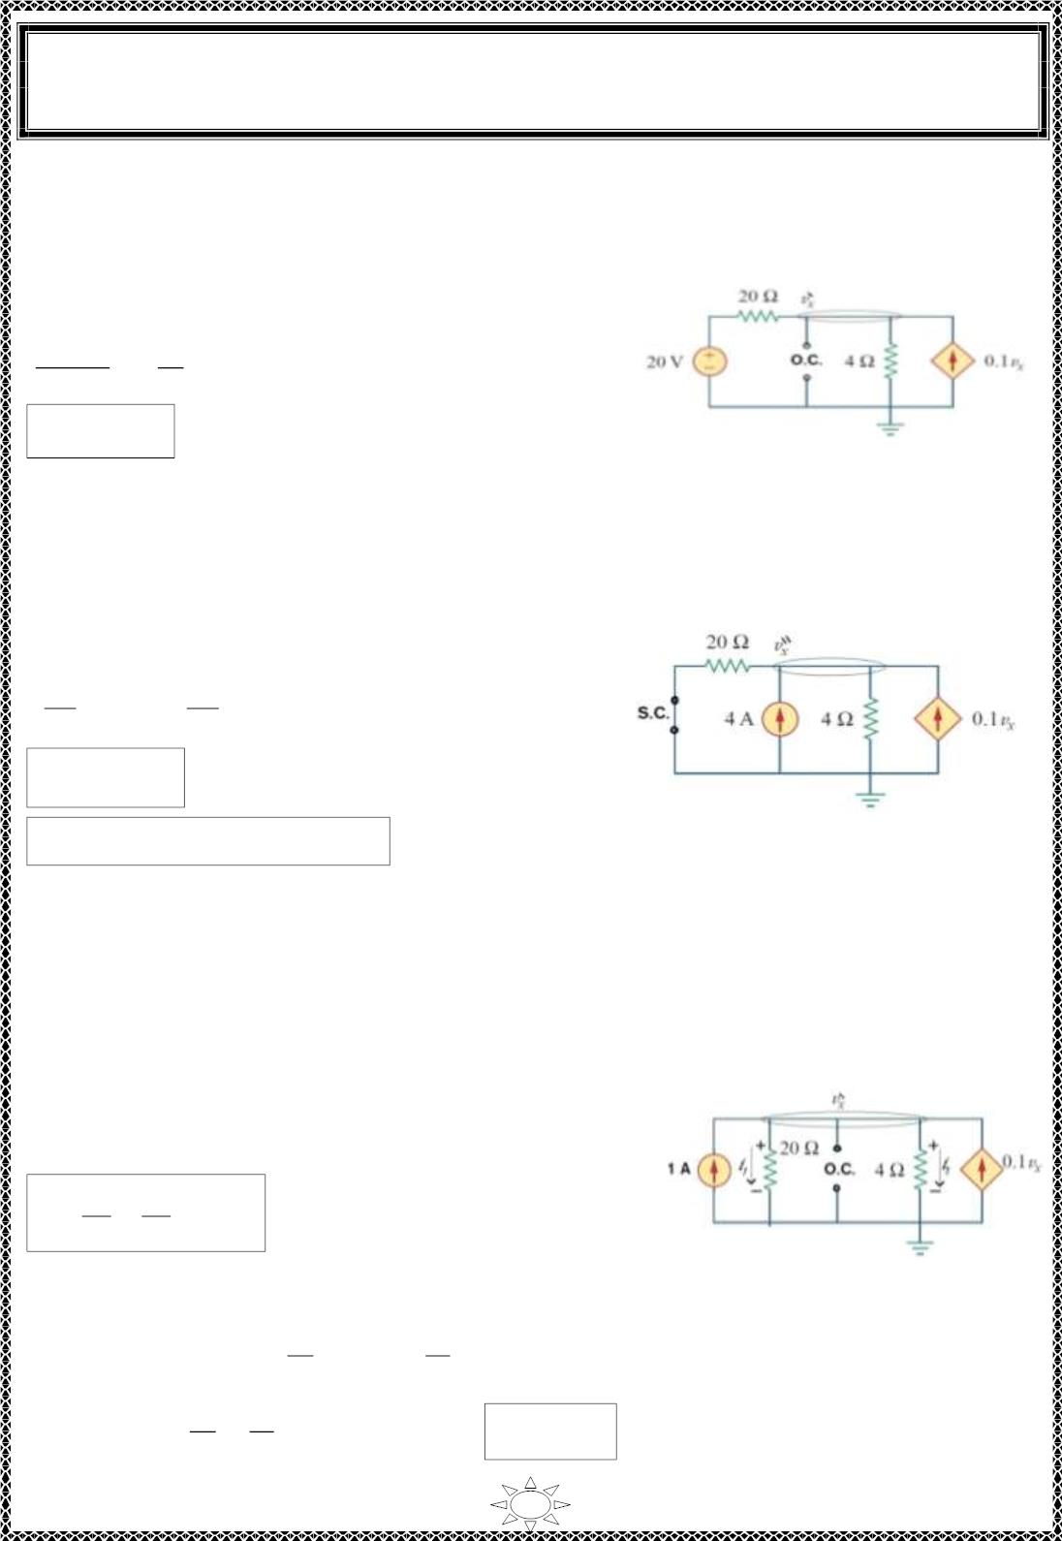
University of Diyala
Engineering College
Electronic Department
Electrical Engineering Fundamentals
1st Class
Asst., Lecturer : Wisam N. AL-Obaidi
Year (2013-2014)
Solution:
1)Let the vo ltage source of (20 V) acting through the circuit and turn off the independent
current source by rep lac in g it by an open circuit and redraw the c ircuit as shown b elo w.
′
Use nodal analys is to find 푣 .
푥
′
′
푣 − 20
푣
푥
푥
+
− 0
′
.1푣 = 0
20
4
푥
∴ 푣_{푥}′ = 5 V
Fig ure (6.5)
2)Let the current source of (4 A) acting through the circuit and turn off the independent
voltage source by replacing it by short circuit and redraw the circuit as s hown b elo w.
′′
Use nodal analys is to find 푣 .
푥
′′
′′
푣
푣
푥
푥
− 4 +
− 0.1 ′′
푣 = 0
푥
Trail Version
Trail Version
Trail Version
Trail Version
Trail Version
Trail Version
Trail Version
Trail Version
Trail Version
Trail Version
Trail Version
Trail Version
20
Trail Version
4
∴ 푣_{푥}′′ = 20 V
∴ v = 푣′ + 푣′′ = 5 + 20 = 25 V
Figure (6.6)
x
푥
푥
Alternative solution:
1)Let the vo ltage source of (20 V) acting through the circuit and turn off the independent
current source by rep lac in g it by an open c irc uit.
Use source transformation and transform the voltage
source of (20 V) to current source and redraw the
circuit as shown in Figure (6 .7).
푉
20
푠
I_{s} =
=
= 1 A
20 20
Apply KCL,
Figure (6.7)
′
′
푣
푣
푥
′
푥
1 + 0.1푣 = i +i , i =
and i₂ =
푥
1
2
1
20
4
′
′
푣
푣
푥
푥
∴ 1 + 0. 1푣′ = +
,
∴ 푣′ = 5 V
푥
20
4
푥
75

Slide 6
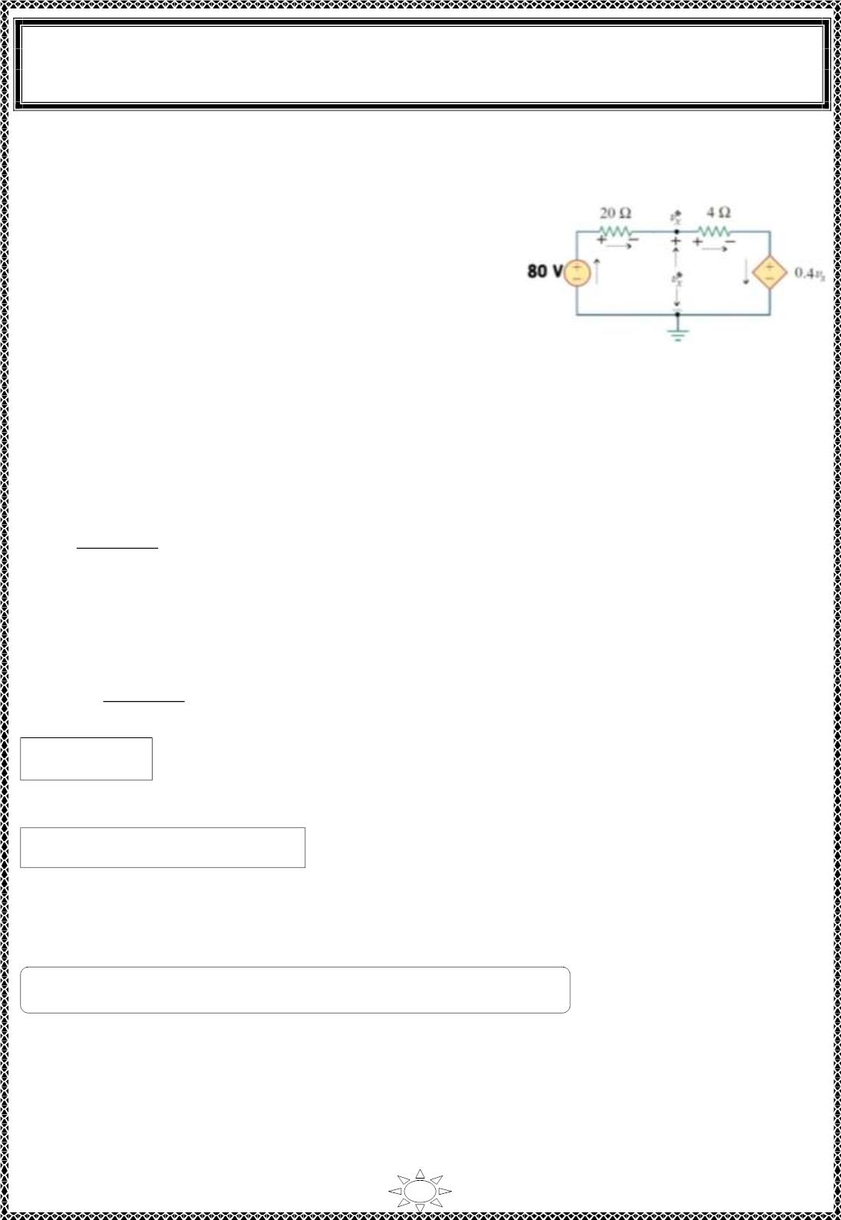
University of Diyala
Engineering College
Electronic Department
Electrical Engineering Fundamentals
1st Class
Asst., Lecturer : Wisam N. AL-Obaidi
Year (2013-2014)
2)Let the current source of (4 A) acting through the circuit and turn off the independent
voltage source by replacing it by short circuit and redraw the circuit as s hown b elo w.
Use source transformation and transform the Current
′′
sources of (4 and 0. 1푣 ) to current source and redraw
푥
the circuit as shown in figure.
V = I × R
se
s
s
= 4 × 20 = 80 V (for independent current source)
Figure (6.8)
= 0. 1푣_{푥}
′′ × 푣′′
4 = 0.4 V (for dependent current source)
푥
Now apply KVL,
′′
-80 + 24i + 0.4푣 =0
푥
′′
∴ i =
80−0.4푣_{푥}
…(1)
…(2)
Trail Version
Trail Version
Trail Version
Trail Version
Trail Version
Trail Version
Trail Version
Trail Version
Trail Version
Trail Version
Trail Version
Trail Version
Trail Version
24
-푣 + 4i + 0.4푣′′ = 0
′′
푥
푥
Substitute equ. (1) in equ.(2), we get,
80−0.4푣′′
′′
푥
푣′′
) + 0.4 = 0
-푣 + 4(
푥
24
푥
∴ 푣_{푥}′′ = 20 V
∴ v = 푣′ + 푣′′ = 5 + 20 = 25 V
x
푥
푥
H.W/ Solve the above examp le by using Mes h Analysis.
76

Slide 7
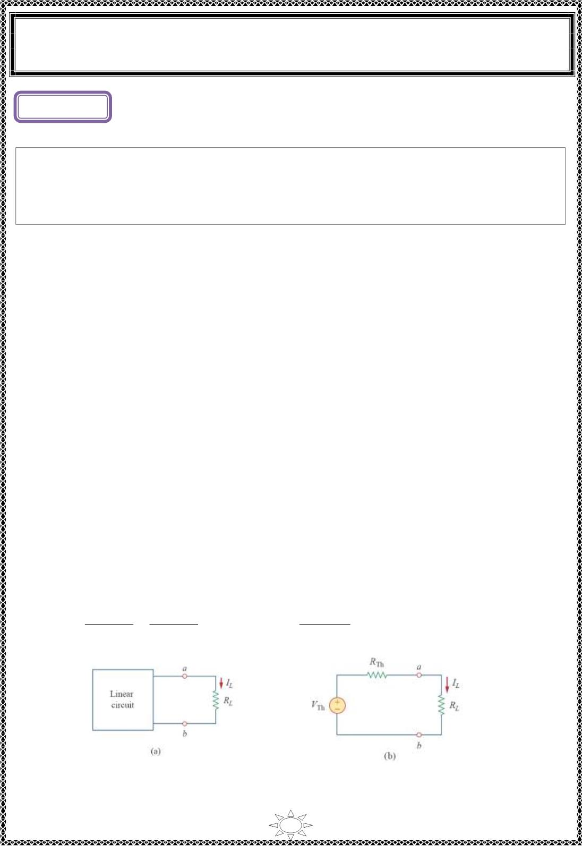
University of Diyala
Engineering College
Electronic Department
Electrical Engineering Fundamentals
1st Class
Asst., Lecturer : Wisam N. AL-Obaidi
Year (2013-2014)
L ectur e (7)
Thevenin’s Theorem
Thevenin’s theorem states that a linear two-terminal c ircuit can be rep laced by an
equiva le nt circuit c ons is ting of a voltage source V in s er ies wit h a res istor R , where
Th
Th
V is the open-circuit voltage at the terminals and R is the input or equivalent
Th
Th
resistance at the terminals when the independent sources are turned off.
How to find Thevenin's equivalent circuit
1) Remove R_{L} from the circuit ter minals A and B and redraw the c irc uit. Ob vio us ly,
the ter minals have become open-circuited.
2) Calculat e the open-circuit vo ltage V_{oc} whic h appears across terminals A and B when
they are open i.e. when R is removed. It is als o called ‗Thevenin vo ltage‘ V .
Trail Version
Trail Version
Trail Version
Trail Version
Trail Version
Trail Version
Trail Version
Trail Version
Trail Version
Trail Version
Trail Version
Trail Version
Trail Version
L
Th
3) Compute the res istance of the whose network as looked into from these two
terminals after all voltage sources have been removed lea v ing behind their internal
resistances (if any) and current sources have been replaced by open-circuit. It is also
called Thevenin resistance R_{Th}.
4) Replace the ent ire network by a single Thevenin source, whose vo ltag e is V_{Th} or V_{oc}
and whose internal res istance is R_{Th.}
5) Connect R_{L} back to its terminals from where it was previously removed.
6) Finally, calculat e the current f lowing through R_{L} by using the equation,
I =
L
푉_{푇ℎ}
=
푉_{표푐}
, V = R I =
푅_{퐿}
푅_{푇ℎ} + 푅_{퐿}
푉
푇ℎ
푅_{푇ℎ} + 푅_{퐿} 푅_{푇ℎ} + 푅_{퐿}
L
L L
Figure (7.1): A circuit with a load: (a) original c irc uit, (b) Thevenin equivalent.
77

Slide 8
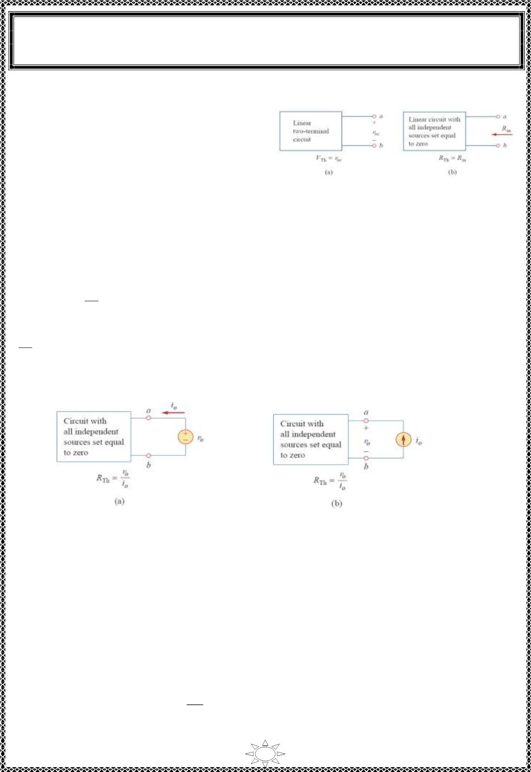
University of Diyala
Engineering College
Electronic Department
Electrical Engineering Fundamentals
1st Class
Asst., Lecturer : Wisam N. AL-Obaidi
Year (2013-2014)
How to find Thevenin's equivalent resistance (R_{Th})
■ C ASE 1 If the ne twork has no dependent
sources, we turn off all independent sources.
R_{Th} is the input resistance of the network
looking between ter minals a and b, as shown
in Figure (7.2-b).
Figure (7.2) : Find ing V and R .
Th Th
■ CASE 2 If the ne twork c ontains both dependent and independent sources, we turn
off all independent sources. As with s uperpos it ion, dependent sources are not to be turned
off because they are controlled by c irc uit variables.
We apply a vo ltage source v at terminals a and b and determine the result ing current.
푣
o
표
Then R_{Th} =
, as shown in Figure (7.3-a). Altern at iv e ly, we may insert a current source
ꢀ
표
i at ter minals a-b as shown in Figure (7.3-b) and f ind the terminal voltage v Aga in R =
o
o
Th
푣
표
. Either of the two approaches will give the same result. In eit her approach we may
Trail Version
Trail Version
Trail Version
Trail Version
Trail Version
Trail Version
Trail Version
Trail Version
Trail Version
Trail Version
Trail Version
Trail Version
ꢀ
Trail Version
표
assume any va lue of v and i For examp le, we may use v =1 V or i =1 A, or even use
o
o
o
o
unspecified values of v or i
o
o
Figure (7.3): Find ing R_{Th} when circuit has dependent sources.
It often occurs that R_{Th} takes a negative value. In th is case, the negative resistance
(v = −iR ) implies that the circuit is s upplying power.
Alternative method: (t his method can ap p lied for circuits doesn't have dependent sources
and for c irc uits have dependent sources)
(i) The open-circuit voltage V_{oc} is determined as usual with the sources activated.
(ii) A short-circuit is applied across the terminals a and b and the value of short-circuit
current i_{sc} is found as us ual.
^{푉}표푐
(iii) Thevenin res istance R_{Th} = . It is the same procedure as adopted for Norton‘s
theorem.
ꢀ푠푐
78

Slide 9
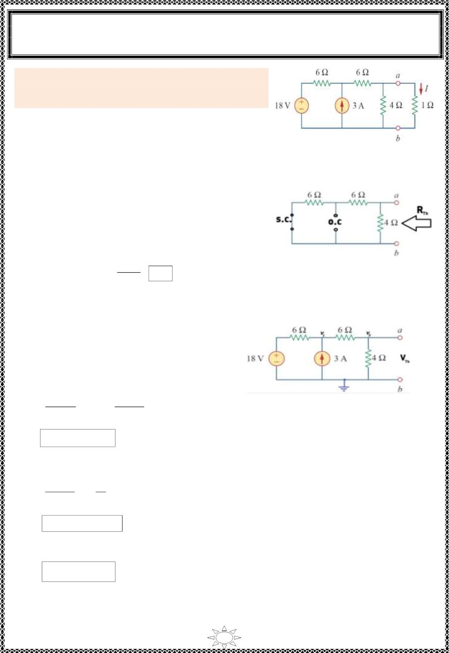
University of Diyala
Engineering College
Electronic Department
Electrical Engineering Fundamentals
1st Class
Asst., Lecturer : Wisam N. AL-Obaidi
Year (2013-2014)
Example 1: Using Thevenin‘s theorem, find the
equiva le nt circuit to the le ft of the terminals in the
circuit of Figure shown. Then f ind I.
Solution:
❖ Remove the branch where the required current
(I) flow through it (the branch RL=1 Ω).
Figure (7.4 )
❖ To find R_{Th} , turn-off all independent sources
i.e. (replace voltage sources by S.C. and replace
current sources by O.S.) as s hown in figure
b elo w.
4
R_{Th} = (6+6)
12 ×4
=
= 3Ω
Figure (7.5)
12 +4
Trail Version
Trail Version
Trail Version
Trail Version
Trail Version
Trail Version
Trail Version
Trail Version
Trail Version
Trail Version
Trail Version
Trail Version
Trail Version
❖ To find V_{Th} , use any method discussed previous ly to find voltage between terminals
a & b, i.e. (V or V ).
oc
Th
Use nodal analysis,
For node (1),
푉₁ − 18
−3 +
푉₁ − 푉
2
= 0
Figure (7.6 )
6
6
2V − V = 36
…(1)
…(2)
1
2
For node (2),
푉₂ − 푉
푉
2
4
6
1
+
= 0
2V − 5V = 0
1
2
Solve Equ.s (1) & (2), we get,
^{V}2 ^{= 9 V = V}
Th
79

Slide 10
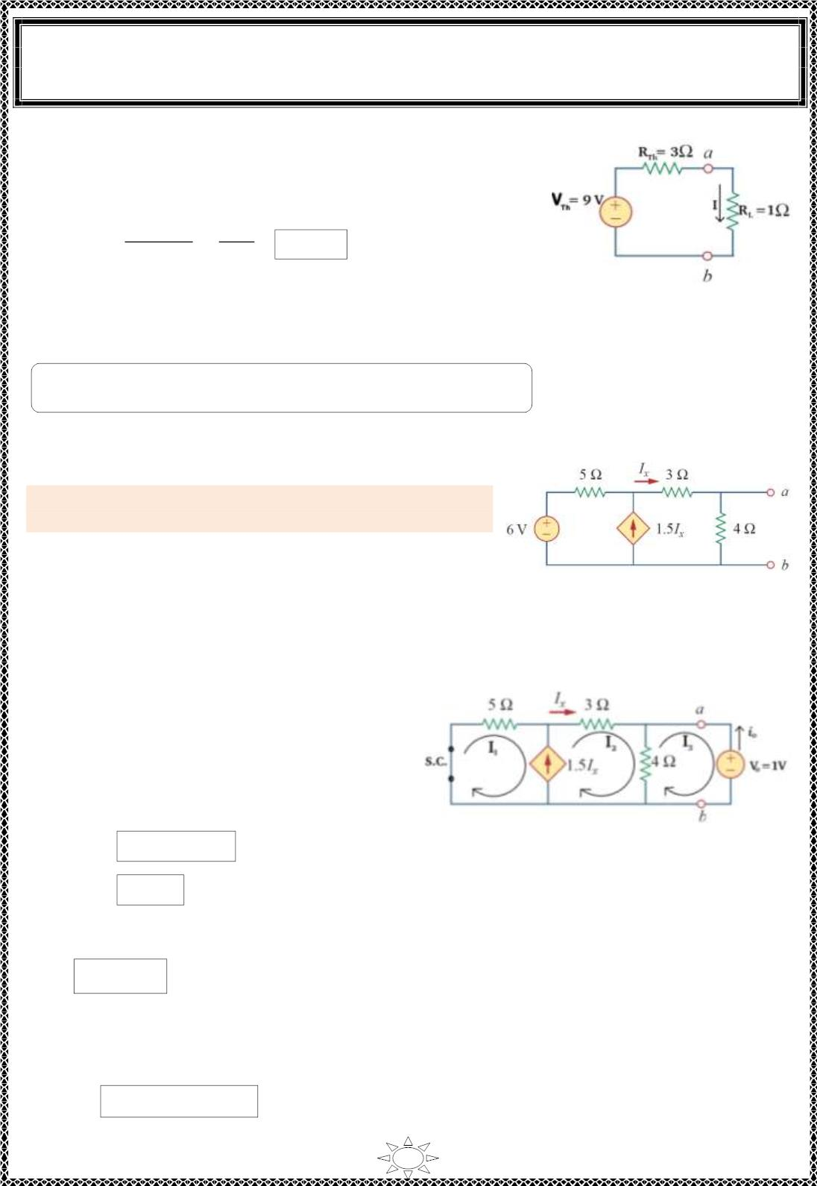
University of Diyala
Engineering College
Electronic Department
Electrical Engineering Fundamentals
1st Class
Asst., Lecturer : Wisam N. AL-Obaidi
Year (2013-2014)
❖ Connect the equivalent Thevenin's c irc uit as shown in
Figure (7.6),
I =
L
푉_{푇ℎ}
푅_{푇ℎ} + 푅_{퐿}
=
9
= 2.25 A
3+ 1
Figure (7.6)
H.W.:- Find V_{Th} for example (1) by using Mesh analys is.
Example 2: Find the Thevenin equivalent circuit of
the circuit shown in Figure to the left of the terminals.
Solution:
Trail Version
Trail Version
Trail Version
Trail Version
Trail Version
Trail Version
Trail Version
Trail Version
Trail Version
Trail Version
Trail Version
Trail Version
Trail Version
Fig ure (7.6)
❖ The c irc uit have dependent source, then to find R_{Th}, turn-off all independent sources
and apply a voltage source (v_{o}=1 V) ac ro ss terminals a & b, then find the source
current (i_{o}) as shown in f igure below.
Use Mesh analysis,
For super mesh (1) & (2),
I = I + 1.5I
x
…(1)
…(2)
Figure (7.7 )
2
1
&
I_{x} = I₂
Substitute equation (2) in (1), we get,
I₁ = -0.5I₂
…(3)
5I + 3I + 4(I – I ) = 0
1
2
2
3
∴ 5I + 7I – 4I = 0
…(4)
1
2
3
80

